Slide 1
Screenshots for YEAR 2018

Slide 2
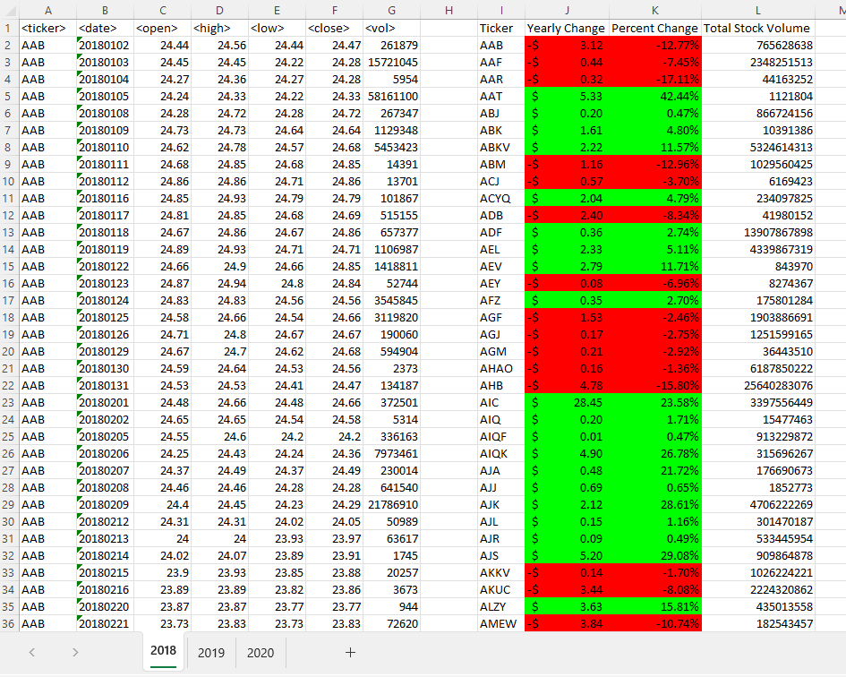

Slide 3
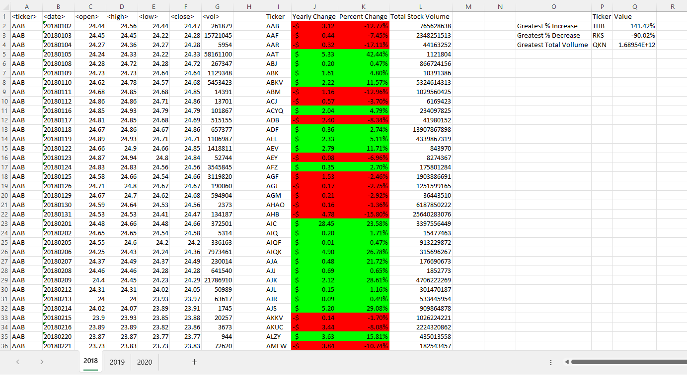

Slide 4
Screenshots for YEAR 2019

Slide 5
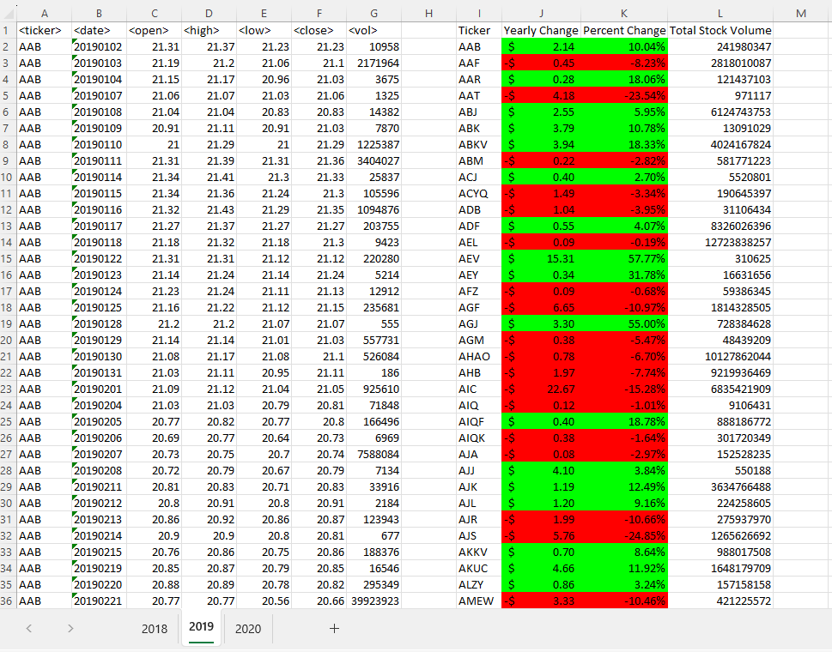

Slide 6
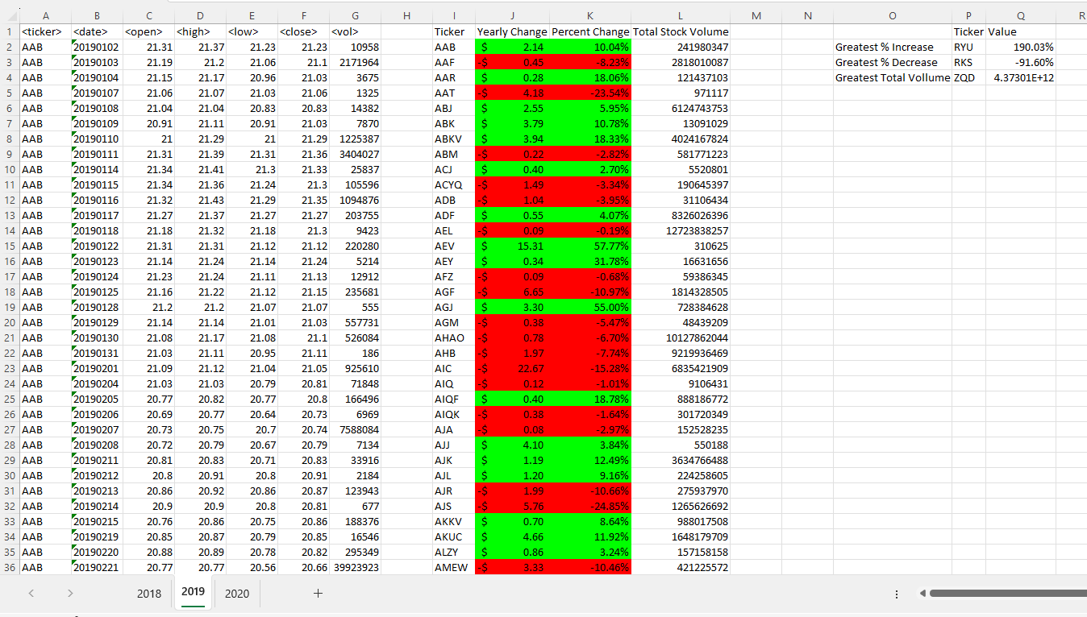

Slide 7
Screenshots for YEAR 2020

Slide 8
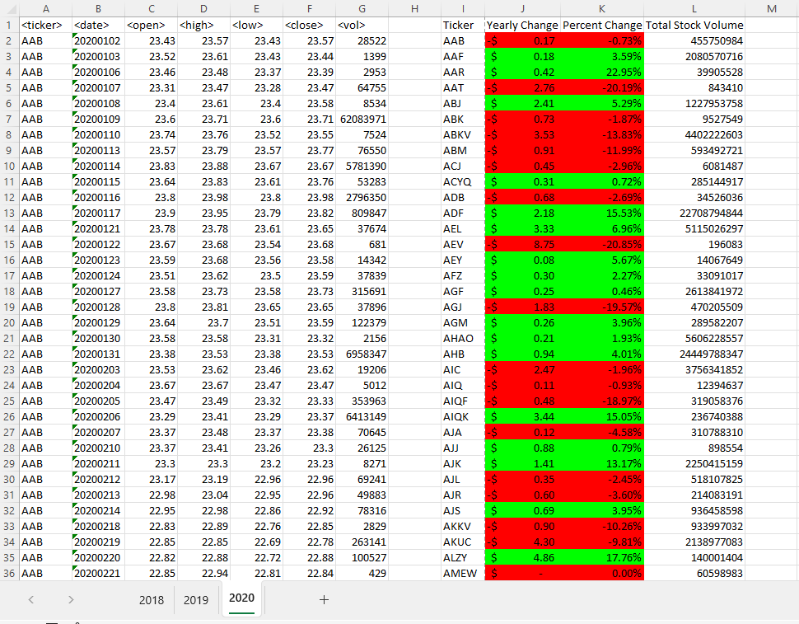

Slide 9
